Slide 1




PROJECT TITLE- AI-Driven Tree-Free Paper
Manufacturing By Trinova
Team Name- TRINOVA AI

Slide 2





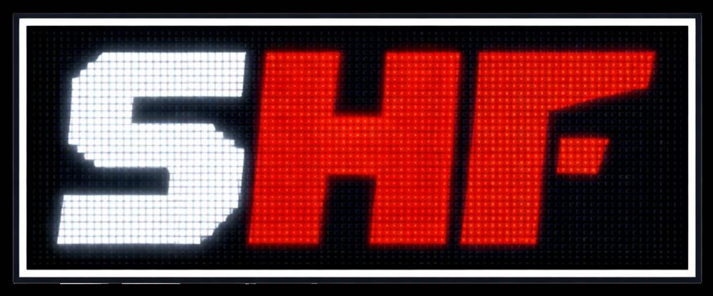

Problem Statement
Detailed Problem Statement:-
Traditional paper manufacturing depends on cutting trees.
Millions of trees are cut every year for paper demand.
Causes deforestation and loss of biodiversity.
Uses large amounts of water and toxic chemicals.
Pollutes rivers, soil, and air.
Recycling alone is not sufficient.
Need for a sustainable and scalable alternative.

Slide 3



Solution:
Create high-quality white paper without cutting trees.
Use AI, material science, and safe chemical engineering.
Eliminate deforestation caused by paper industry.
Maintain strength, brightness, and durability of paper.
Support global climate action goals.
Build AI-powered smart paper factories.
Make tree-free paper the global standard.
Eliminates chlorine pollution & Reduces industrial waste.
Supports circular economy.
Data-driven fiber and chemical selection.

Slide 4



Dependencies and Showstopper
vhg
1
3
Raw Material Dependency.
Cost & Infrastructure Showstopper.
Continuous supply of agri-waste and alternative fibers.
High initial setup and upgrade costs
Seasonal availability and logistics challenges
Limited compatibility with existing
paper mills.
2
4
AI & Technology Dependency.
Regulation & Market Adoption Showstopper
High-quality data for AI optimization.
Certification and environmental approvals needed
Skilled AI and chemical expertise required.
Market trust and adoption take time.

Slide 5



Highlights/Difference between exisiting solution
TRADITIONAL METHOD
TRINOVA AI METHOD
Cuts millions of trees annually
Uses chlorine for bleaching
High water consumption (10L/sheet)
Releases harmful chemicals
Non-renewable resource dependency
Zero trees cut- ever
Oxygen & hydrogen peroxide bleaching 70% less water consumption
Non-toxic,biodegradable chemicals Renewable agricultural waste inputs.

Slide 6

Frontened
Backend
APIs &
HTML, CSS,
JavaScript, React.js/Next.js.
Node.js,Express.js, Firebase/MangoDB, Rest APIs.
Integrations
Cloud APIs, Model APIs.
AI and Machine
Learning
Devops and Depolyment
Python, Machine learning Models, Data Analytics & Optimization.
Git & GitHub CI/CD Pipelines Netlify/ Vercel Cloud Hosting
TECH STACK

Slide 7

TEAM NAME: TRINOVA AI
Name
College Name
College Location
Position
Gender
Pancheti Charitha Siddartha Institute of Science & Technology Puttur
O.Pavani Siddhartha Institute of Engineering & Technology Puttur Komma Thanuja Siddhartha Institute of Engineering & Technology Puttur
Frontened/Backend
Female
Machine learning
Female
Devops/Deployment
Female

